Slide 1

Introduction to CUDA (5) Performance Considerations
Parallel Computing

Slide 2
Resources and Performance
并行程序的性能会因计算硬件的资源限制而有很大差异。
在不同的应用中，不同的限制可能会占主导地位并成为瓶颈。
重要的是要找到：
CUDA设备中的主要资源限制类型；
它们如何影响内核执行性能。

Slide 3
Content
Global Memory Bandwidth
More on Memory Parallelism
Warps and SIMD Hardware
Dynamic partitioning of resources

Slide 4
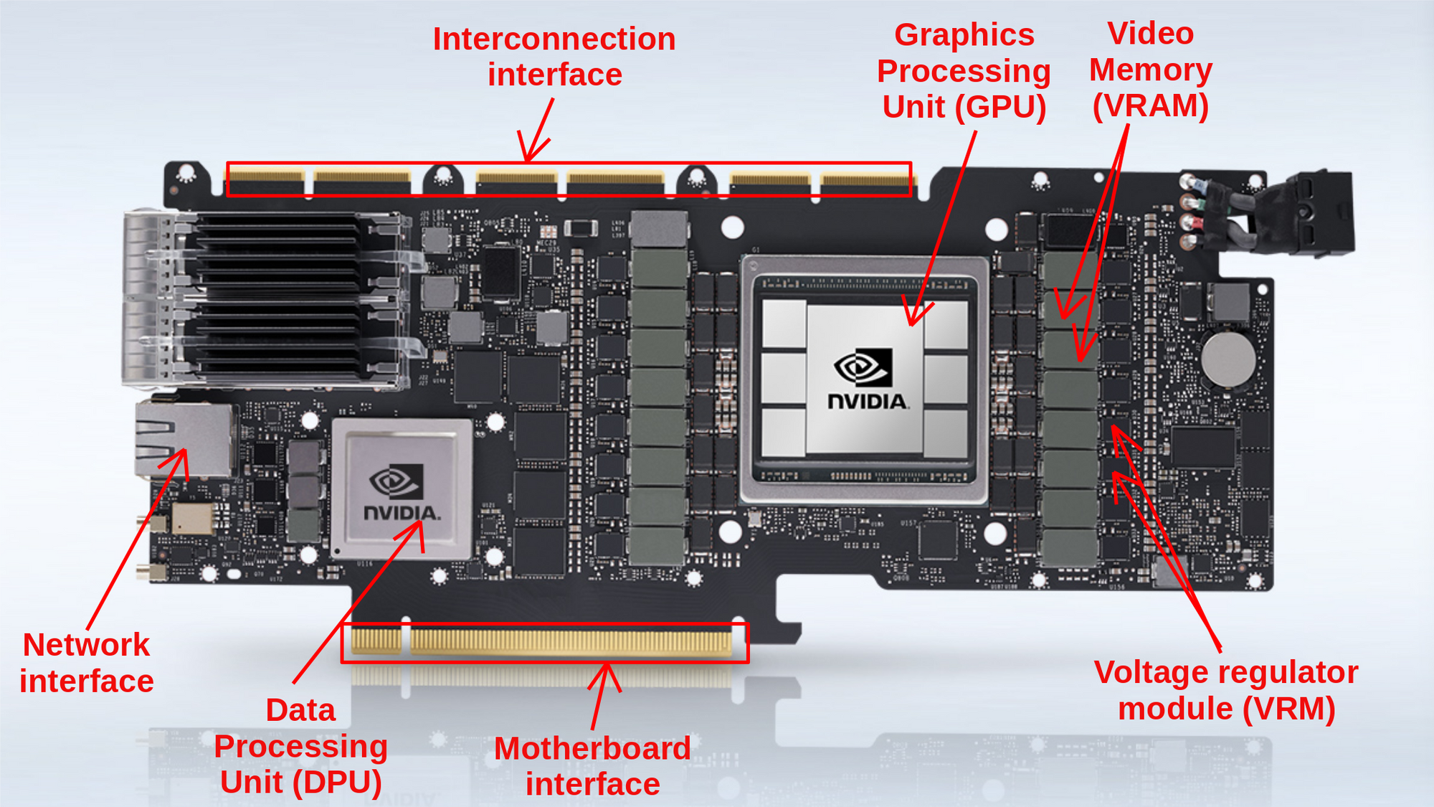
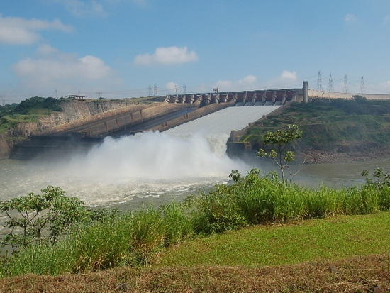

Global Memory Bandwidth
Ideal
Reality

Slide 5
DRAM core arrays are slow
从存储阵列的一个单元格中读取数据是一个非常缓慢的过程。
About 1000 cells connected to each vertical line
decode
A very small capacitance that stores a data bit
To sense amps
10s of nanoseconds v.s. sub-nanosecond clock cycle
Like determine the flavor of cup of coffee by smelling far away

Slide 6
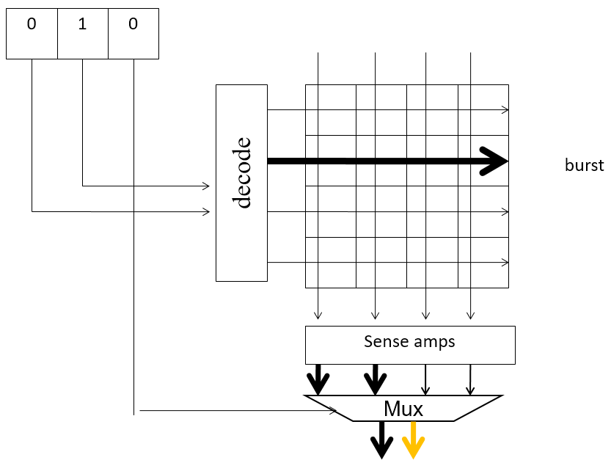
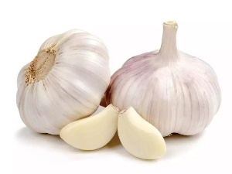
DRAM Burst
每次访问DRAM的某一个位置时，实际上访问的是一系列包含所请求位置的连续位置。
(burst size = 4 bits)
这些被访问并传送的连续位置被称为DRAM的bursts.

Slide 7
Coalesce （合并）
两个要点：
一个 warp 中的所有线程在任何给定时间都执行相同的指令.
现代DRAM系统所设计的读写模式始终以burst方式执行.
实现理想的访问模式 ：
当一个 warp 中的所有线程访问全局内存中连续的位置.
在这种情况下，硬件会将所有这些访问合并为对连续DRAM位置（ burst ）的统一访问，称为 coalesces 。

Slide 8
A 2D C Array in Linear Memory Space
访问C语言多维数组元素时，内存地址是如何组织的?
M_{0,0}
M_{0,1}
M_{0,2}
M_{0,3}
M_{1,0}
M_{1,1}
M_{1,2}
M_{1,3}
M_{2,0}
M_{2,1}
M_{2,2}
M_{2,3}
M_{3,0}
M_{3,1}
M_{3,2}
M_{3,3}
M
M_{0,0}
M_{0,1}
M_{0,2}
M_{0,3}
M_{1,0}
M_{1,1}
M_{1,2}
M_{1,3}
M_{2,0}
M_{2,1}
M_{2,2}
M_{2,3}
M_{3,0}
M_{3,1}
M_{3,2}
M_{3,3}
linearized order in increasing address

Slide 9
DRAM Burst – A System View
Burst section
Burst section
Burst section
Burst section
0
1
2
3
4
5
6
7
8
9
10
11
12
13
14
15
每个地址空间被划分为 burst sections
每次访问一个位置时，同一部分中的所有其他位置也会被传送到处理器。
基本示例：一个16字节的地址空间，4字节的burst
在实际应用中，我们至少有4GB的地址空间，burst 大小为128字节或更大

Slide 10
Memory Coalescing
Coalesced Loads
Coalesced Loads
T₀
T₁
T₂
T₃
T₀
T₁
T₂
T₃
0
1
2
3
4
5
6
7
8
9
10
11
12
13
14
15
Burst section
Burst section
Burst section
Burst section
当一个 warp 中的所有线程执行加载指令时，
如果所有访问的位置都落在同一个burst section,
那么只需要发出一个DRAM请求，
这时访问是完全合并的（fully coalesced）.

Slide 11
Un-coalesced Accesses
Un-coalesced Loads
Un-coalesced Loads
T₀
T₁
T₂
T₃
T₀
T₁
T₂
T₃
0
1
2
3
4
5
6
7
8
9
10
11
12
13
14
15
Burst section
Burst section
Burst section
Burst section
当访问的位置跨越burst section的边界时:
Coalescing fails
会发出多次DRAM请求，耗时增加

Slide 12
A Simple Matrix Multiplication Kernel (review)
__global__
void MatrixMulKernel(float* M, float* N, float* P, int Width)
{
// Calculate the row index of the P element and M
int Row = blockIdx.y * blockDim.y + threadIdx.y;
// Calculate the column index of P and N
int Col = blockIdx.x * blockDim.x + threadIdx.x;
if ((Row < Width) && (Col < Width)) {
float Pvalue = 0;
// each thread computes one element of the block sub-matrix
for (int k = 0; k < Width; ++k)
Pvalue += M[Row*Width+k] * N[k*Width+Col];
P[Row*Width+Col] = Pvalue;
}
}

Slide 13
Two Access Patterns
For M, threads in a warp read adjacent rows;
For N, threads in a warp read adjacent columns;
d_M
d_N
Thread 1
H
T
D
I
Thread 2
W
WIDTH
(a)
(b)
M[Row*Width+k]
N[k*Width+Col]
k is loop counter in the inner product loop of the kernel code

Slide 14
N accesses are coalesced.
N_{0,0}
N_{0,1}
N_{0,2}
N_{0,3}
k*Width:
same across all threads within a given iteration of the k loop.
Access direction in Kernel code
N_{1,0}
N_{1,1}
N_{1,2}
N_{1,3}
N_{2,0}
N_{2,1}
N_{2,2}
N_{2,3}
Col:
Col=blockIdx.x*blockDim.x+threadIdx.x
blockIndx.x and blockDim.x are same for all threads in the same block.
time
N_{3,0}
N_{3,1}
N_{3,2}
N_{3,3}
N[k*Width+Col]
Load iteration 0
Load iteration 1
…
T₀
T₁
T₂
T₃
T₀
T₁
T₂
T₃
N
N_{0,0}
N_{0,1}
N_{0,2}
N_{0,3}
N_{1,0}
N_{1,1}
N_{1,2}
N_{1,3}
N_{2,0}
N_{2,1}
N_{2,2}
N_{2,3}
N_{3,0}
N_{3,1}
N_{3,2}
N_{3,3}

Slide 15

M accesses are not coalesced.
time
M_{0,0}
M_{0,1}
M_{0,2}
M_{0,3}
k & Width:
same across all threads within a given iteration of the k loop.
Access direction in Kernel code
M_{1,0}
M_{1,1}
M_{1,2}
M_{1,3}
Row:
Row=blockIdx.y*blockDim.y+threadIdx.y
blockIndx.x and blockDim.x are same for all threads in the same block.
M_{2,0}
M_{2,1}
M_{2,2}
M_{2,3}
M_{3,0}
M_{3,1}
M_{3,2}
M_{3,3}
M[Row*Width+k]
…
Load iteration 1
T₀
T₁
T₂
T₃
Load iteration 0
T₀
T₁
T₂
T₃
M
M_{0,0}
M_{0,1}
M_{0,2}
M_{0,3}
M_{1,0}
M_{1,1}
M_{1,2}
M_{1,3}
M_{2,0}
M_{2,1}
M_{2,2}
M_{2,3}
M_{3,0}
M_{3,1}
M_{3,2}
M_{3,3}

Slide 16
Use shared memory to enable coalescing in tiled matrix multiplication
d_M
d_N
Original
H
Access
T
D
I
Pattern
W
Corner Turning
WIDTH
Copy into
scratchpad
memory
d_M
d_N
Tiled
Access
Pattern
Perform
multiplication
with scratchpad
values

Slide 17
Tiled Matrix Multiplication Kernel
__global__ void MatrixMulKernel(float* M, float* N, float* P, int Width){
1. __shared__ float Mds[TILE_WIDTH][TILE_WIDTH];
2. __shared__ float Nds[TILE_WIDTH][TILE_WIDTH];
3. int bx = blockIdx.x; int by = blockIdx.y;
4. int tx = threadIdx.x; int ty = threadIdx.y;
// Identify the row and column of the P element to work on
5. int Row = by * TILE_WIDTH + ty;
6. int Col = bx * TILE_WIDTH + tx;
7. float Pvalue = 0;
// Loop over the M and N tiles required to compute the P element
8. for (int ph = 0; ph < Width/TILE_WIDTH; ++ph) {
// Collaborative loading of M and N tiles into shared memory
9. Mds[? ][? ] = M[ ? ];
Nds[? ][? ] = N[ ? ];
__syncthreads();
12. for (int k = 0; k < TILE_WIDTH; ++k)
13. Pvalue += Mds[ty][k] * Nds[k][tx];
14. __synchthreads();
15. }
16. P[Row*Width+Col] = Pvalue;
}

Slide 18
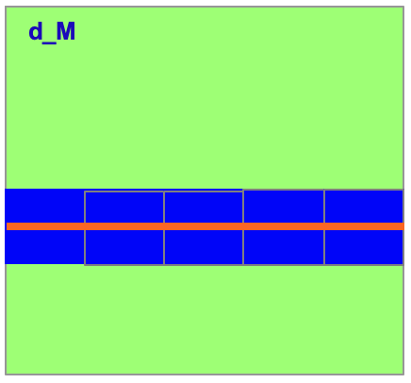
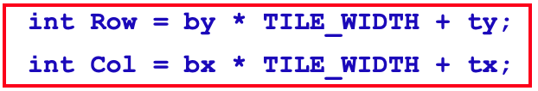
Load M elements
M[Row][ph*TILE_WIDTH+tx].
column index used by the threads only differs in terms of threadIdx.
row index is determined by blockIdx.y and threadIdx.y
threads in the same thread block have identical blockIdx.y/threadIdx.y and adjacent threadIdx.x
Mds[ty][tx] = M[Row*Width + ph*TILE_WIDTH + tx]
threadIdx.x

Slide 19
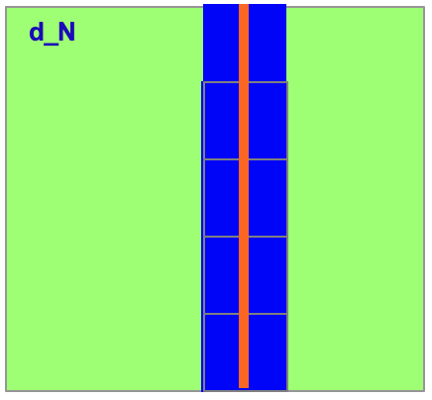
Load N elements
N[ph*TILE_WIDTH+ty][bx*TILE_WIDTH+tx].
the row index ph*TILE_WIDTH+ty has the same value for all threads with the same threadIdx.y value.
the column index calculation for each thread, Col=bx*TILE_WIDTH+tx, where bx*TILE_WIDTH is the same for all threads in the same block
Nds[ty][tx] = N[(ph*TILE_WIDTH + ty)*Width + Col];
threadIdx.x

Slide 20
Tiled Matrix Multiplication Kernel
__global__ void MatrixMulKernel(float* M, float* N, float* P, int Width){
1. __shared__ float Mds[TILE_WIDTH][TILE_WIDTH];
2. __shared__ float Nds[TILE_WIDTH][TILE_WIDTH];
3. int bx = blockIdx.x; int by = blockIdx.y;
4. int tx = threadIdx.x; int ty = threadIdx.y;
// Identify the row and column of the P element to work on
5. int Row = by * TILE_WIDTH + ty;
6. int Col = bx * TILE_WIDTH + tx;
7. float Pvalue = 0;
// Loop over the M and N tiles required to compute the P element
8. for (int ph = 0; ph < Width/TILE_WIDTH; ++ph) {
// Collaborative loading of M and N tiles into shared memory
9. Mds[ty][tx] = M[Row*Width + ph*TILE_WIDTH + tx];
Nds[ty][tx] = N[(ph*TILE_WIDTH + ty)*Width + Col];
__syncthreads();
12. for (int k = 0; k < TILE_WIDTH; ++k)
13. Pvalue += Mds[ty][k] * Nds[k][tx];
14. __synchthreads();
15. }
16. P[Row*Width+Col] = Pvalue;
}
~30x

Slide 21
Content
Global Memory Bandwidth
More on Memory Parallelism
Warps and SIMD Hardware
Dynamic partitioning of resources

Slide 22
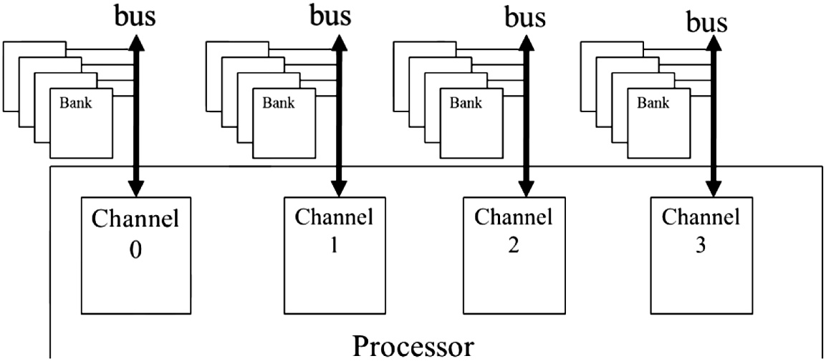
Bursting is not sufficient
更进一步，DRAM系统通常采用两级并行组织形式 :
– banks and channels.
在最高层次上，处理器包含一个或多个通道（channels）.
每个通道是一个内存控制器，它通过总线将一组DRAM中的bank连接到处理器.

Slide 23
Number of Channels
总线的数据传输带宽（ bandwidth ）由其宽度和时钟频率决定 :
For example, a 64-bit DDR bus with a clock frequency of 1 GHz has a bandwidth of 8B*2*1 GHz = 16 GB/sec
这个带宽看上去不小，但对现代 CPUs/GPUs的数据吞吐率还不够：
CPU → 32GB/s → 2 channels
GPU→ 128GB/s → 8 channels

Slide 24
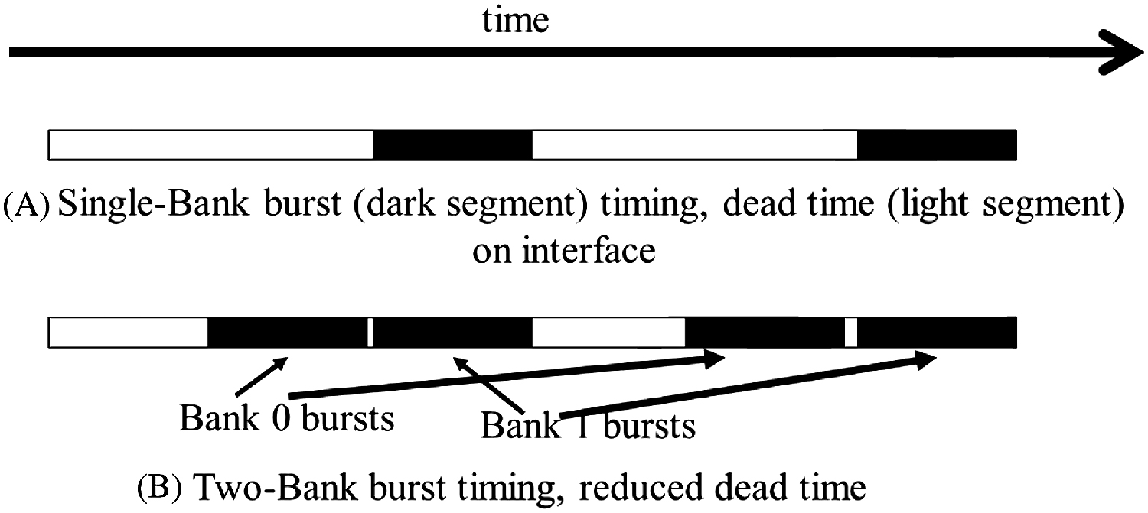
Number of Banks
对于每个channel，bank的数量由充分利用总线带宽来决定:

Slide 25
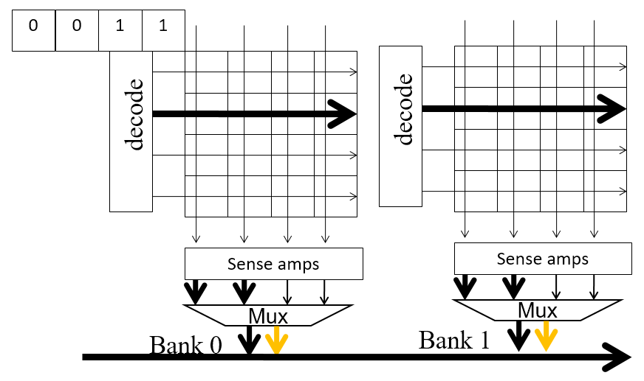
Multiple DRAM Banks
Bank的数量：
In general, if the ratio of the cell array access latency and data transfer time is R, we need to have at least R+1 banks.
Reasons to have more banks:
Avoid bank conflicts;
Manufacturability;

Slide 26
Data Distribution
两个系统之间的匹配非常重要：
parallel execution of threads and the parallel organization of the DRAM system:
sufficient number of threads making simultaneous memory accesses.
these memory accesses must be evenly distributed to the channels and banks.
each access to a bank must also be a coalesced access.

Slide 27
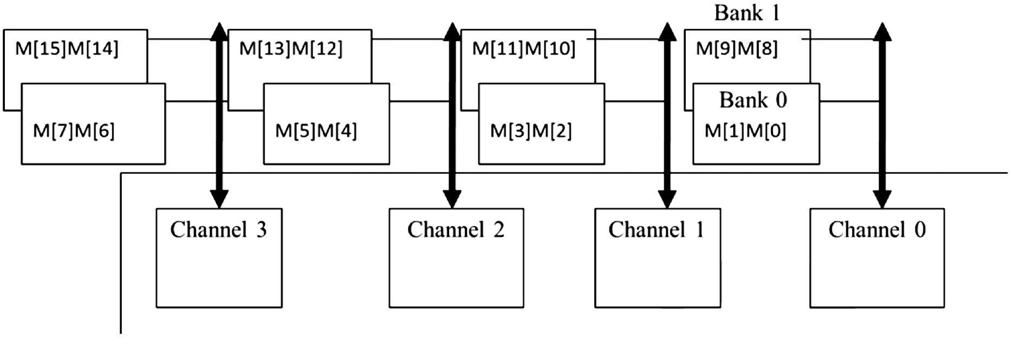
Data Distribution
数据分配方案将元素分散到系统中的各个bank和channel中。 :
Interleaved data distribution

Slide 28
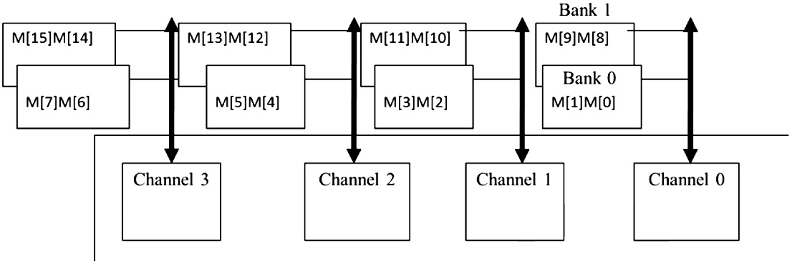
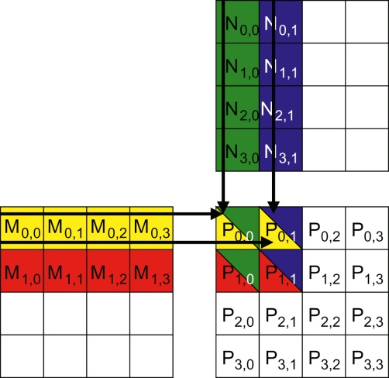
Interleaved Data Distribution
Example:
用2×2 线程块，2×2 数据瓦片， 做乘法
Parallel coalesced accesses will be made to the two banks in channel 0 as well as the two banks in channel 2.

Slide 29

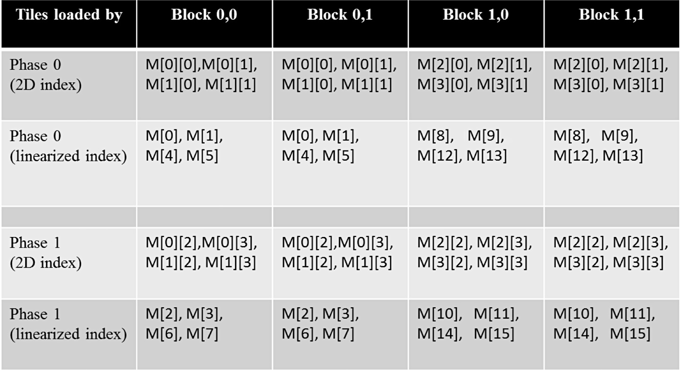
Interleaved Data Distribution
Example:
cache
如果使用同样的2×2线程块，做 8×8 矩阵的乘法:
将会使用多少通道?
4
Notes:
All 4 channels

Slide 30
Content
Global Memory Bandwidth
More on Memory Parallelism
Warps and SIMD Hardware
Dynamic partitioning of resources

Slide 31
Warps as Scheduling Units
Each block is divided into 32-thread warps
An implementation technique
Warps 是 SM中的基本调度单元
Warp中的线程执行单指令多数据模式 (SIMD)
在未来，一个 warp 中的线程数量可能会有所不同。
Block 1 Warps
Block 2 Warps
Block 3 Warps
…
…
…
…
…
…
t0 t1 t2 … t31
t0 t1 t2 … t31
t0 t1 t2 … t31

Slide 32
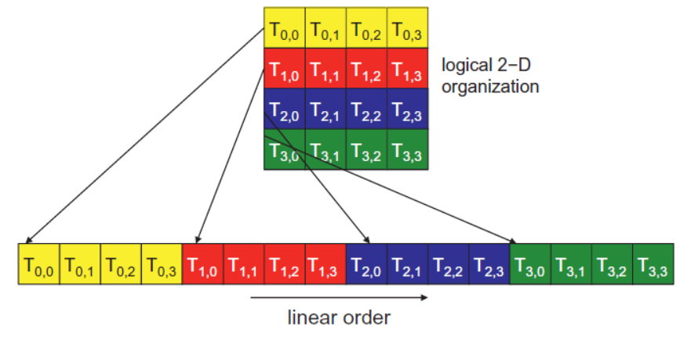
Warps in Multi-dimensional Thread Blocks
对于多维线程块，被划分成 warp 之前，它们首先按照行主序展开成一维数组形式：
In x-dimension first, y-dimension next, and z-dimension last
For this example, all 16 threads form half a warp.
The warp will be padded with another 16 threads to complete a 32-thread warp.

Slide 33
Blocks are partitioned after linearization
一维展开的线程块进一步划分：
一个 warp 内的线程索引是连续且递增的
Warp 0 starts with Thread 0
划分方案在不同设备上是一致的
Thus you can use this knowledge in control flow
However, the exact size of warps may change from generation to generation
不要依赖 warp 内部或 warp 之间的任何顺序
如果线程之间存在任何依赖关系，
必须使用__syncthreads()来获得正确的结果.

Slide 34
SMs are SIMD Processors
Control unit for instruction fetch, decode, and control is shared among multiple processing units
Control overhead is minimized
Memory
I/O
Processing Unit
Shared Memory
Register
File
ALU
Control Unit
PC
IR
Processor (SM)
Notes:
Insert von-neumann schematic here

Slide 35
SIMD Execution Among Threads in a Warp
在任何时间点，一个 warp 中的所有线程都必须执行相同的指令。
为取得高运行效率，所有线程遵循相同的控制流路径（same control flow path）
All if-then-else statements make the same decision
All loops iterate the same number of times
Notes:
WARP_SIZE

Slide 36
Control Divergence
控制分歧（Control divergence）
发生在一个 warp中的线程由于不同的控制决策而走上不同的控制流路径。
一些线程执行 if 语句的 then 分支，而另一些执行 else 分支。
一些线程执行的 循环迭代次数 不同于其他线程。
在当前的 GPU 架构中，执行不同路径的线程是串行化（serialized）执行的：
线程束（warp）中不同的控制流路径依次执行，直到所有路径都执行完毕。
在执行某条路径时，所有遵循该路径的线程并行执行，而其他线程处于闲置状态。
当控制流嵌套较深时，可能会产生大量不同的执行路径，导致执行效率下降。
Notes:
WARP_SIZE

Slide 37
Control Divergence Examples
当分支或循环条件中包含线程索引时，可能会出现控制分歧:
Example kernel statement with divergence:
if (threadIdx.x > 2) { }
这为块中的线程创建了两条不同的控制路径 决策粒度小于 warp 大小；
线程 0、1 和 2 与第一个 warp 中的其他线程遵循不同的路径
Example without divergence:
If (blockIdx.x > 2) { }
决策粒度是块大小的倍数；
任何给定 warp 中的所有线程都遵循相同的路径.

Slide 38
Example: Vector Addition Kernel
Device Code
// Compute vector sum C = A + B
// Each thread performs one pair-wise addition
__global__
void vecAddKernel(float* A, float* B, float* C, int n)
{
int i = threadIdx.x + blockDim.x * blockIdx.x;
if(i<n) C[i] = A[i] + B[i];
}

Slide 39
Analysis for vector size of 1,000 elements
Assume that block size is 256 threads
8 warps in each block
All threads in Blocks 0, 1, and 2 are within valid range
i values from 0 to 767
There are 24 warps in these three blocks, none will have control divergence
Most warps in Block 3 will not control divergence
Threads in the warps 0-6 are all within valid range, thus no control divergence
One warp in Block 3 will have control divergence
Threads with i values 992-999 will all be within valid range
Threads with i values of 1000-1023 will be outside valid range
Effect of serialization on control divergence will be small
1 out of 32 warps has control divergence
The impact on performance will likely be less than 3%

Slide 40
Performance Impact of Control Divergence
边界条件检查对于并行代码的完整功能和健壮性至关重要
分块矩阵乘法内核有许多边界条件检查
问题是这些检查可能会导致显著的性能下降。
例如，参见下面的分块加载代码:
if(Row < Width && t * TILE_WIDTH+tx < Width) {
ds_M[ty][tx] = M[Row * Width + p * TILE_WIDTH + tx];
} else {
ds_M[ty][tx] = 0.0;
}
if (p*TILE_WIDTH+ty < Width && Col < Width) {
ds_N[ty][tx] = N[(p*TILE_WIDTH + ty) * Width + Col];
} else {
ds_N[ty][tx] = 0.0;
}

Slide 41
Two types of blocks in loading M Tiles
1. Blocks whose tiles are all within valid range until the last phase.
2. Blocks whose tiles are partially outside the valid range all the way
M
Type 1
TILE_WIDTH
Type 2

Slide 42
Analysis of Control Divergence Impact
Assume 16x16 tiles and thread blocks
Each thread block has 8 warps (256/32)
Assume square matrices of 100x100
Each thread will go through 7 phases (ceiling of 100/16)
There are 49 thread blocks (7 in each dimension)

Slide 43
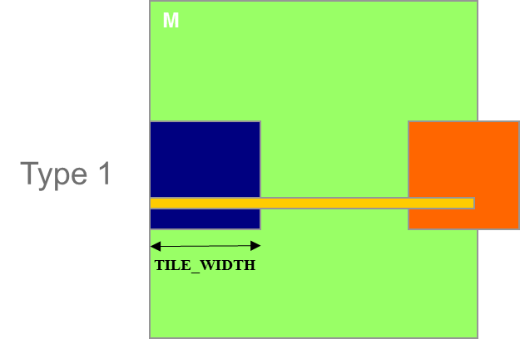
Control Divergence in Loading M Tiles
There are 49 thread blocks (7 in each dimension)
Type 1:
There are 42 (6*7) Type 1 blocks, with a total of 336 (8*42) warps
They all have 7 phases, so there are 2,352 (336*7) warp-phases
The warps have control divergence only in their last phase
336 warp-phases have control divergence

Slide 44
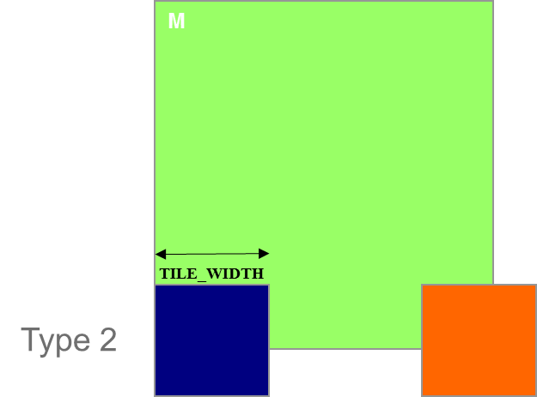
Control Divergence in Loading M Tiles (Type 2)
There are 49 thread blocks (7 in each dimension)
Type 2:
the 7 block assigned to load the bottom tiles, with a total of 56 (8*7) warps
They all have 7 phases, so there are 392 (56*7) warp-phases
The first 2 warps in each Type 2 block will stay within the valid range until the last phase
The 6 remaining warps stay outside the valid range
So, only 14 (2*7) warp-phases have control divergence

Slide 45
Overall Impact of Control Divergence
Type 1 Blocks: 336 out of 2,352 warp-phases have control divergence
Type 2 Blocks: 14 out of 392 warp-phases have control divergence
The performance impact is expected to be less than 12% (350/2,944 or (336+14)/(2352+14))
M
Type 1
TILE_WIDTH
Type 2

Slide 46
Additional Comments
控制分歧带来的性能影响与数据相关：
对于较大的矩阵，影响将显著减小。
通常，对于大型输入数据集的边界条件检查，控制分歧的影响应该是微不足道的（insignificant）
不应担心使用边界检查会导致性能大幅下降。
结论：即使内核中有控制流（ control flow ）指令，并不意味着会出现大量的控制流分歧（ control divergence ）。

Slide 47
Content
Global Memory Bandwidth
More on Memory Parallelism
Warps and SIMD Hardware
Dynamic partitioning of resources

Slide 48
Execution resources
一个SM中的可用计算资源包括:
registers,
shared memory,
thread block slots,
and thread slots.
这些资源是以动态划分（ dynamically partitioned ）的方式分配给线程使用的。
Notes:
WARP_SIZE

Slide 49
Execution resources
Thread slots:
这些线程槽在运行时分区并分配给线程块.
例如：Fermi架构的设备拥有1536个线程槽.
如果每个线程块由512个线程组成，那么1536个线程槽将被分区并分配给三个线程块。
在这种情况下，由于线程槽的限制，每个流多处理器（SM）最多可以容纳三个线程块。
如果每个线程块包含256个线程，那么1536个线程槽将被分区并分配给六个线程块。
这种在线程块之间动态分配线程槽的能力使得流多处理器（SM）具有很高的灵活性。
Notes:
WARP_SIZE

Slide 50
Execution resources
Block slots: 块槽
要注意线程槽和块槽之间的匹配关系.
例如：费米架构设备有1536个线程槽位.
如果每个块有128个线程，那么这1536个线程槽位可以被划分并分配给12个块。
然而，由于每个流处理器（SM）只有8个块槽位，因此只允许有8个块。
这意味着最终，只有1024个线程槽位会被利用。
因此，为了充分利用块槽位和线程槽位，每个块至少需要有256个线程。
Notes:
WARP_SIZE

Slide 51
Execution resources
Registers:
在 CUDA 内核中声明的自动变量会被放置到寄存器中.
例如：假设每个流处理器（SM）有 16,384 个寄存器.
如果内核每个线程使用 10 个寄存器，且线程块大小为 16×16，那么每个 SM 上能运行多少线程呢？
10×16×16 = 2560 六个块所需的寄存器数量是 15,360。可以。
再添加一个块就需要 17,920 个寄存器？不行。 那么再添加两个自动变量呢？
12×16×16 = 3072；六个块现在所需的寄存器数量是 18,432。不行。
CUDA 运行时会将分配给每个 SM 的块数量减少一个.
然而，这会使得在 SM 上运行的线程数量从 1536 降低到 1280。
“性能悬崖”“performance cliff”
Notes:
WARP_SIZE

Slide 52
Execution resources
Shared memory:
共享内存： 另一种在运行时动态划分的资源。
例如: Tiled algorithms
需要大量的共享内存才能发挥其优势。
但大量的共享内存使用会减少在 SM 上运行的线程块数量.
减少的线程并行性可能会对内存访问带宽的利用率产生负面影响;
内存访问吞吐量减少，反过来又会进一步降低线程执行吞吐量.
Notes:
WARP_SIZE

Slide 53
Execution resources
可以看到，所有动态划分资源的约束条件以复杂的方式相互作用.
CUDA Occupancy Calculator
CUDA 占用率计算器
一个可下载的 Excel 表格
根据特定设备上内核对资源的使用情况，计算每个 SM 上实际运行的线程数量。
Notes:
WARP_SIZE

Slide 54
Estimate Occupancy
int blockSize; // The launch configurator returned block size
int minGridSize; // The minimum grid size needed to achieve the maximum occupancy for a full device launch
int gridSize; // The actual grid size needed, based on input size
float potentialOccupancy;
size_t dynamicSMemUsage = 0;
static double reportPotentialOccupancy(void *kernel, int blockSize, size_t dynamicSMem)
{
cudaDeviceProp prop;
int device; numBlocks; activeWarps; maxWarps;
double occupancy;
checkCudaErrors(cudaGetDevice(&device));
checkCudaErrors(cudaGetDeviceProperties(&prop, device));
checkCudaErrors(cudaOccupancyMaxActiveBlocksPerMultiprocessor(
&numBlocks, kernel, blockSize, dynamicSMem));
activeWarps = numBlocks * blockSize / prop.warpSize;
maxWarps = prop.maxThreadsPerMultiProcessor / prop.warpSize;
occupancy = (double)activeWarps / maxWarps;
return occupancy;
}

Slide 55
Estimate Occupancy
cudaOccupancyMaxPotentialBlockSize( &minGridSize, &blockSize,
(void*)kernel_xxx, 0, 0));
gridSize = (num + blockSize - 1) / blockSize; // Round up
kernel_xxx<<<gridSize, blockSize>>>();
checkCudaErrors(cudaDeviceSynchronize());
potentialOccupancy = reportPotentialOccupancy((void*)kernel_xxx, blockSize, dynamicSMemUsage);
std::cout << “kernel_xxx blockSize: ” << blockSize << “, gridSize/minGridSize: ” << gridSize << “ / ” << minGridSize << ", Potential occupancy: " << potentialOccupancy * 100 << "%" << std::endl;

Slide 56
summary
在大规模并行处理器中，内存带宽是影响性能的首要因素。
DRAM 的burst、bank和channel
所有这些概念也适用于现代多核处理器（GPU）。
内存合并 coalescing 对于有效利用 CUDA 中的内存带宽很重要
它的起源是 DRAM 中的burst机制。
检查 CUDA 内存访问是否已合并。
掌握改进 CUDA 代码中内存合并的技术（tile）。

Slide 57
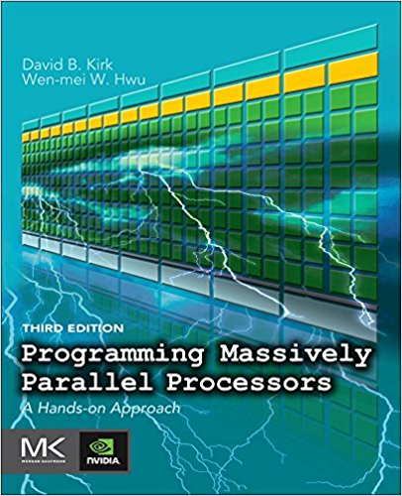
Reference
CUDA C Programming Guide,
https://docs.nvidia.com/cuda/cuda-c-programming-guide/index.html
Programming Massively Parallel Processors,
A Hands-on Approach
Third Edition
Chapter 5

